Slide 1
Secure Data Hiding in Images Using Steganography
Presented By: Gurrampati Baba Mokhabeer
Student Name : Gurrampati Baba Mokhabeer
College Name & Department : Bharath Institute Of Higher Education & CSE

Slide 2

OUTLINE
Problem Statement
Technology used
Wow factor
End users
Result
Conclusion
Git-hub Link
Future scope

Slide 3

Problem Statement
📌 Objective:
The primary goal of this project is to implement a steganography-based system that securely hides a secret message within an image using encryption and retrieves it through decryption with a passcode.
🚦 Background:
With increasing concerns about data security and privacy, traditional methods of data transmission are often susceptible to interception. Steganography provides an innovative solution by embedding information within digital media, making the communication not only secure but also inconspicuous.
💡 Proposed Solution:
Encryption Phase:
Hide a user-inputted secret message within an image.
Decryption Phase:
Retrieve and decode the hidden message from the image.

Slide 4
Technology used
Programming Language:
Python 3: Core language for scripting and automation.
Libraries:
OpenCV: For image processing.
NumPy: For array manipulation.
Tkinter: For building a graphical user interface (GUI).
Steganography & Security:
LSB Steganography: Used for embedding hidden messages within images.
Passcode-Based Access Control: Ensures only authorized decryption.
Development Platform:
Operating System: Windows.
IDEs: Visual Studio Code (VS Code) or PyCharm for coding.
Image Processing Format:
Supported Formats: JPEG & PNG for embedding and extraction.
GUI Framework:
Tkinter Notebook: Provides a tabbed interface.
TTK: Offers modern and enhanced UI elements

Slide 5



Wow factors
Dual-Layer Security
Combines steganography with AES encryption for enhanced data protection.
Adaptive Image Selection
Uses Al to determine the best images for embedding hidden messages.
Robust Detection Resistance
Minimizes statistical anomalies, making detection nearly impossible

Slide 6

End users
Who Benefits from This Project?
Government Agencies: Utilized for secure communication and intelligence operations.
Corporations: Protects sensitive business data from industrial espionage.
General Users: Allows individuals to privately communicate without detection.

Slide 7
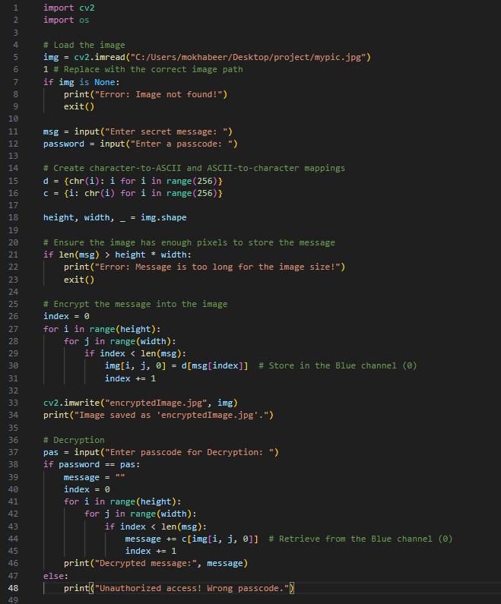

Results
Output Image
Comparison between the original and steganographed image
Original Image
Encryption & Decryption code
Steganographed
Image

Slide 8



Conclusion
Key Takeaways from the Project
Enhanced Data Security
Combining encryption and steganography for improved protection.
Real-World Applications
Useful for secure communication, corporate data protection, and privacy.
Future Enhancements
Potential for Al-driven automation and quantum-safe cryptography.

Slide 9
GitHub Link
https://github.com/mokhabeer16/Steganography.git

Slide 10
Future scope(optional)
Enhanced Security Features
Support for Different File Types
Improved Steganography Techniques
Cross-Platform Compatibility
Automation and AI Integration
Batch Processing
Cloud Storage Integration
User Experience Enhancements
Educational and Research Potential
Community & Collaboration

Slide 11
THANK YOU

